Slide 1
CNC foam cutter
Fannar Andrason
Kristján Orri Magnússon
Sveinn Haukur Albertsson

Slide 2
Functional Requirements
Cut airfoils out of foam for ornithopter design research(Leifur)
Wing profile must be able to vary with span
  Twist, variable camber, sweep etc.
Specified tolerances +/- 0,5 mm
The requested dimensions are 50 cm wide, 25 cm high and 1 m long.
Objective:
  Make the machine cheaper than if imported
  Tailormake to the costumers needs.

Slide 3
Design Parameters
Hot resistance wire (Ni-Chr)
Each end driven by 2 stepper motors(X-Y)
Wire attach point on each end move independently in respective moving plane
Wire able to elongate/shorten without loosing tension -> spring mechanism

Slide 4
Design considerations
Main challenge: Prevention of jamming and bending
  Center of action considerations
  Saint Venants principle for bearings (3-5 rule...)
For best precision the machine has to be as stiff as possible
  While keeping material cost at minimum
Axiomatic design
  All parts replaceable without complicity
  Parts that demand high precision built separately
  Electrical and mechanichal parts decoupled

Slide 5
DP - Software
User input: Define airfoil profiles for each end + define a reference point (i.e. location of max camber)
A software interprets sketches and creates input signals for steppers, subject to:
  Movement of each end starts at the reference point
  Cutting time the same for each end to ensure correct lofting
    Bigger profile on one end -> more speed of movement

Slide 6
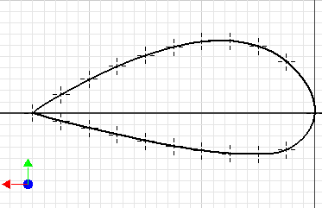
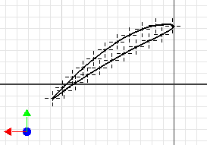
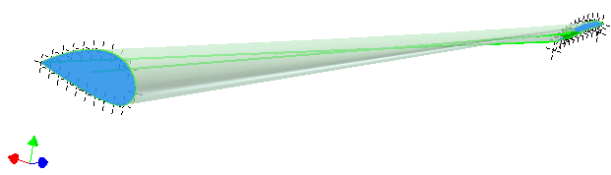
DP – user input
Sketch 1:
Sketch 2:
Ref pts.
NACA9440
NACA6410 (30° twist)
Result:

Slide 7
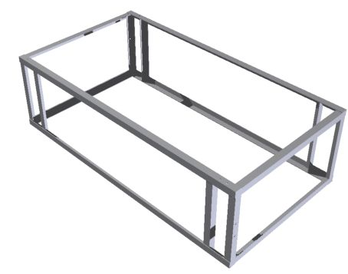
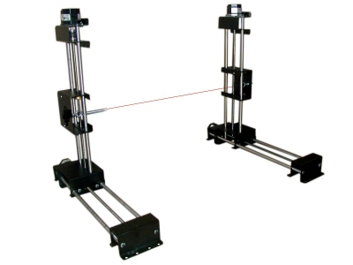
Frame structure
Standard L – profiles to maximize stiffness/weight and affordability.
Relatively easy to assemble/weld with good precision
Mounting platform for other parts
Foamlinks hotwire cutter

Slide 8
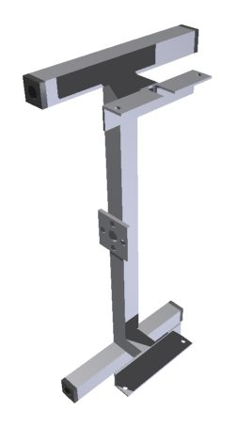
X - Slider
Standard box and L-profiles
Plug-bearing made out of POM
  Low friction on steel rod
Y – slider bolted to L-profile
A very demanding part to build!
  Precision, precision…

Slide 9
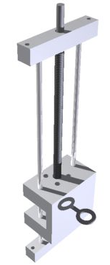
Y - Slider
A steel rod on each side of lead screw to constrain the part to correct degrees of freedom
POM plastic
  Electrical insulation
  Low friction
  Easy to press-fit rods
Lead nut bolted to inside of slider

Slide 10
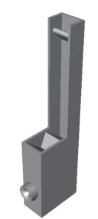
Spring mechanism
Wire changes direction 90°
  Rounded guide (half-wheel 60mm dia)
Adjustable spring tension
  About 150N estimated sufficient
Rounded leader to ensure correct position of wire end

Slide 11
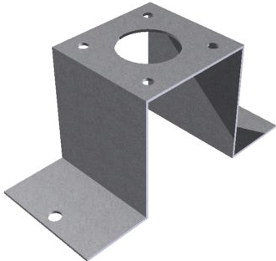
Motor mounts
Sheet metal 1 mm thickness
Stiff for constrained degrees of freedom but flexible to allow for imperfect fabrication

Slide 12
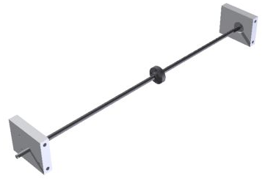
Lead screws and nuts
Ordered from Master Carr
Trapezoidal threads
10 mm dia, same as CNC mill
Pitch 2 mm
Very hard to find in Iceland which means they are the most critical components of the machine!

Slide 13
Hot-wire
Preliminary tests indicate that about 3A of current is sufficient to allow for slow movement(about 4 mm/s maximum) without kerf being inconsistent and/or too thick
Tension of about 150N sufficient to keep wire straight and prevent unwanted bending of wire

Slide 14
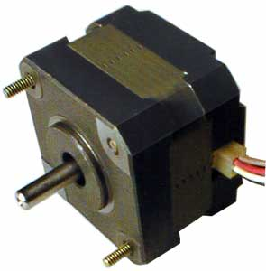
Steppers
After „feel“-testing steppers the following conclusions were made:
  Precision(1,8° per step) sufficient to allow for no gearing -> Direct coupling using stop screws
  24V input voltage gives sufficient torque
  Maximum step input frequency of about 700 Hz means that maximum speed of lead nut can be about 6 mm/s

Slide 15
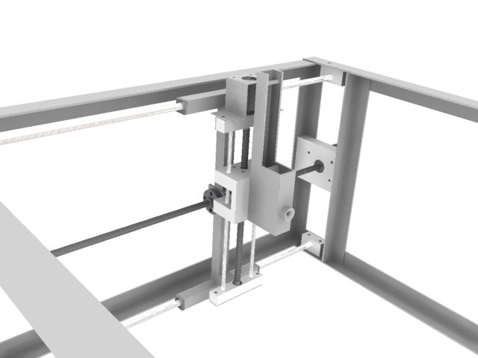
A closer look

Slide 16
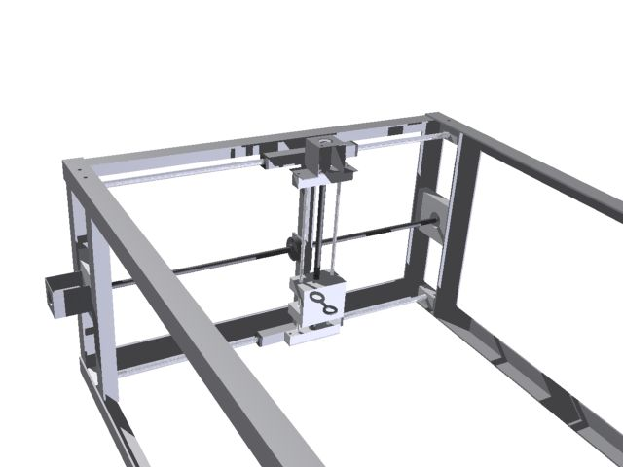
A closer look

Slide 17
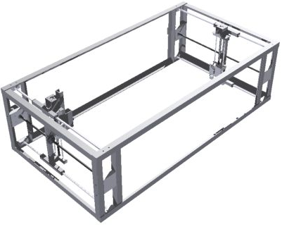
Current status
Final design ready
Workplans ready
Preliminary hardware tests complete
Stepper motors and lead screws on order
Next step: Start building!

Slide 18
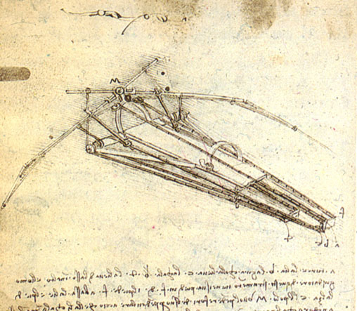
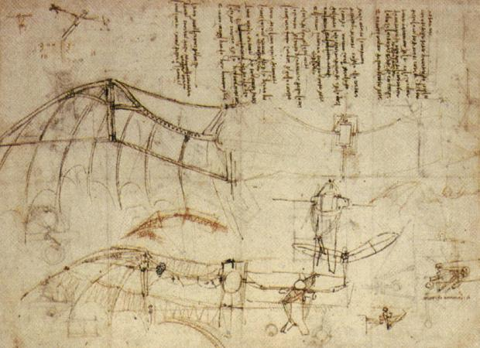
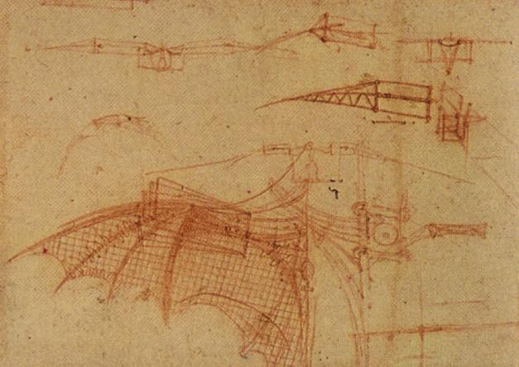
Thank you
Da Vinci’s ornithopter design (1488)

